Slide 1


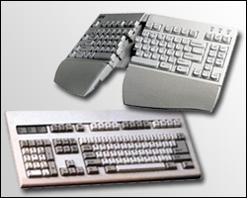
Computer
Safety
Back Safety
Eye Safety
By Ms. D.
Wrist Safety
Quiz

Slide 2
Back Safety
How to protect your Back
Back Facts
  80% people of people may have back issues
  2
Practice back safety
  1
  2
  3
Main Menu
Eye Safety
Wrist Safety

Slide 3
Eye Safety
How to protect your Eyes
Eye Facts
  40% of people develop eye complaints from using computers
  Watch Out..
Practice Eye Safety
  1
  2
  3
Main Menu
Wrist Safety
Back Safety

Slide 4
Wrist or Hand Safety
Steps to Healthy Hands
Hand
Main Menu
Back Safety
Eyes Safety

Slide 5
Safety Quiz
Main Menu
Credits
Wrist Safety
Back Safety
Eye Safety

Slide 6
Credits
Project for EDT 512
Spring 2010
Leslie Dauer
Information from
  Steps to Safe Computing
Images
  www.osha.gov

